Slide 1
Modeling Methodology of CTN Detrapping CTN Cell Information Method

Slide 2
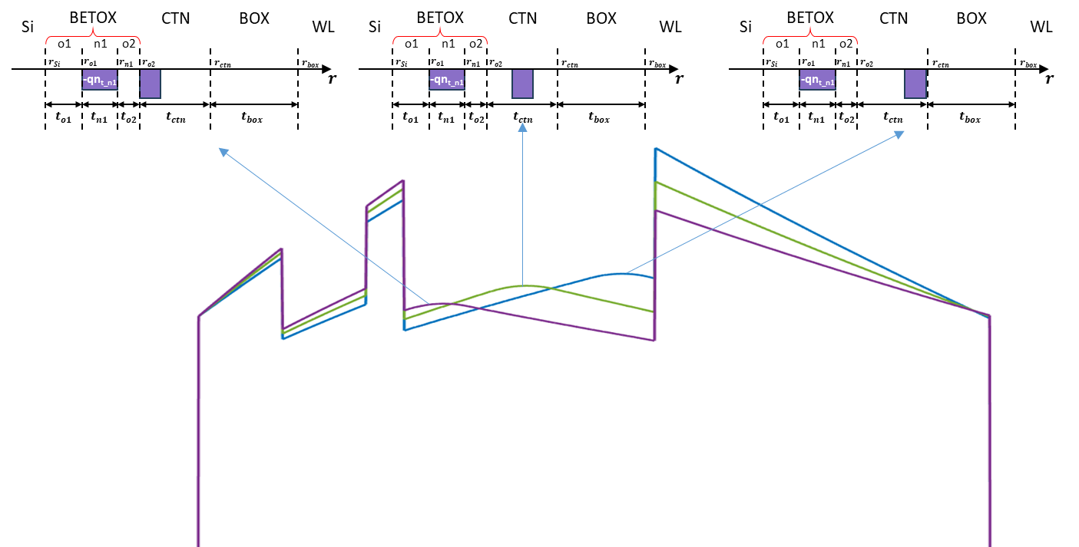
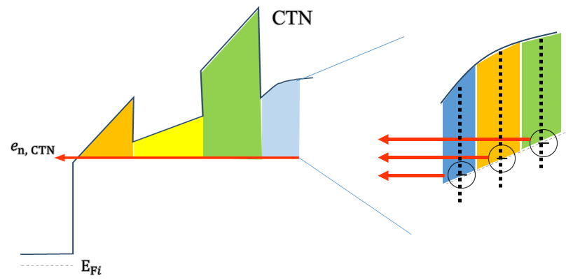
Remind) Detailed Poisson Solution
Remind) Detailed Poisson solution has been calculated
CTN Detrapping Emission Modeling based on Detailed Poisson Solution

Slide 3
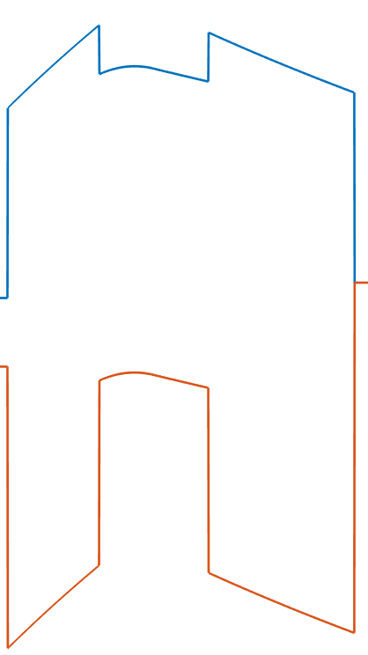
Cell Information Methodology
E_{c}
…
…
…
C_{ij}
…
E_{g}
E_{v}
Each cell C_{ij} contains informations
Location (i)
Trap depth (j)
Trap concentration
Emission rate to channel direction
Emission rate to wordline direction

Slide 4
Cell Information Methodology
r
E_{c}
E_{t}
E_{t, j}
C_{ij}
E_{g}
r_{i}
E_{v}
Location (i)
Trap depth (j)
Used for cell monitoring
Location & trap depth saved at center point

Slide 5
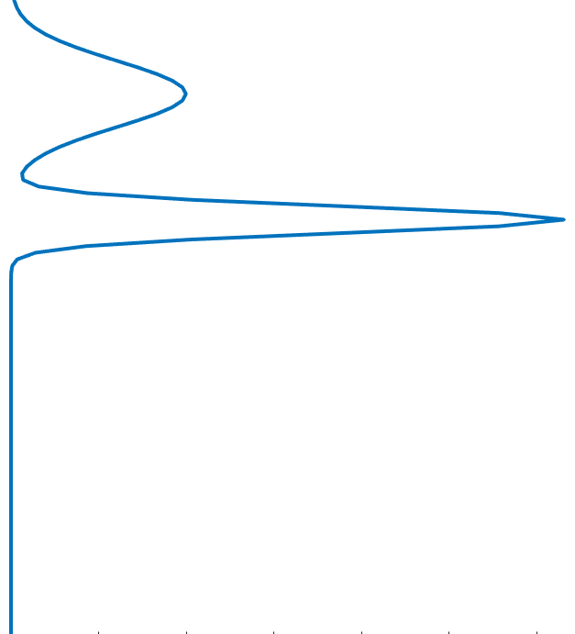


Cell Information Methodology
Trap concentration
- local trap concentration based on location & trap depth
$n_{t}= ∫D_{t}\left(E_{t}\right)dE_{t}$
…
$n_{t0,i,j}=D_{t}dE_{t}$
…

Slide 6
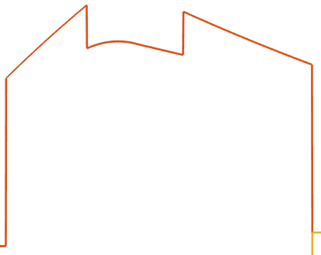



Cell Information Methodology
Emission rate to channel direction
(5) Emission rate to wordline direction
Electron emission to channel
$e_{ch}=ν_{ch}×{\left|TC\right|}_{ch}$
$e_{WL}=ν_{WL}×{\left|TC\right|}_{WL}$
Electron emission to wordline
WL
channel
$$n_{t}=\sum_{i, j}{n_{t,i,j}}=\sum_{i, j}{n_{t0,i,j} \left\{\exp\left(−e_{ch,i,j} t\right)+\exp\left(−e_{WL,i,j} t\right)\right\}}$$

Slide 7
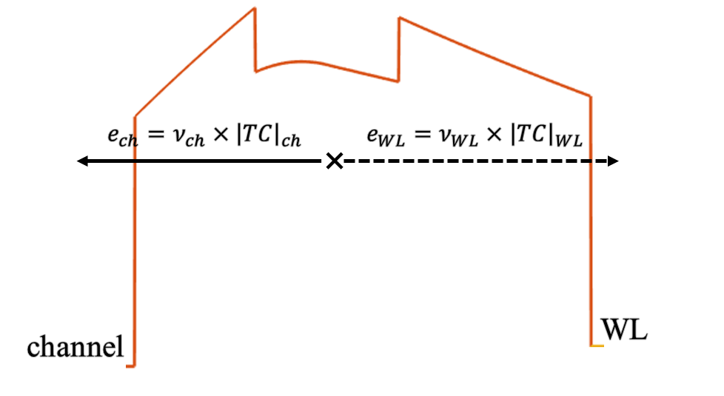
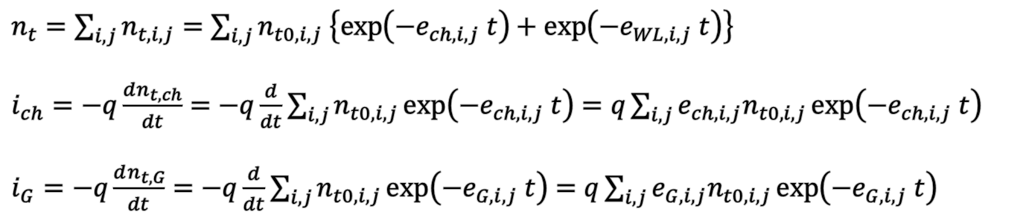
Equivalent Circuit
Equivalent circuit modeling as dependent current source
ΔV_{th}
i_{G}
i_{ch}
$n_{t}=\sum_{i, j}{n_{t,i,j}}=\sum_{i, j}{n_{t0,i,j} \left\{\exp\left(−e_{ch,i,j} t\right)+\exp\left(−e_{WL,i,j} t\right)\right\}}$
$i_{ch}=−q\frac{dn_{t, ch}}{dt}=−q\frac{d}{dt}\sum_{i, j}{n_{t0,i,j}\exp\left(−e_{ch,i,j} t\right)}=q\sum_{i, j}{e_{ch,i,j}n_{t0,i,j}\exp\left(−e_{ch,i,j} t\right)}$
$i_{G}=−q\frac{dn_{t, G}}{dt}=−q\frac{d}{dt}\sum_{i, j}{n_{t0,i,j}\exp\left(−e_{G,i,j} t\right)}=q\sum_{i, j}{e_{G,i,j}n_{t0,i,j}\exp\left(−e_{G,i,j} t\right)}$
=> Modeling by leakage current is on progress

